Slide 1
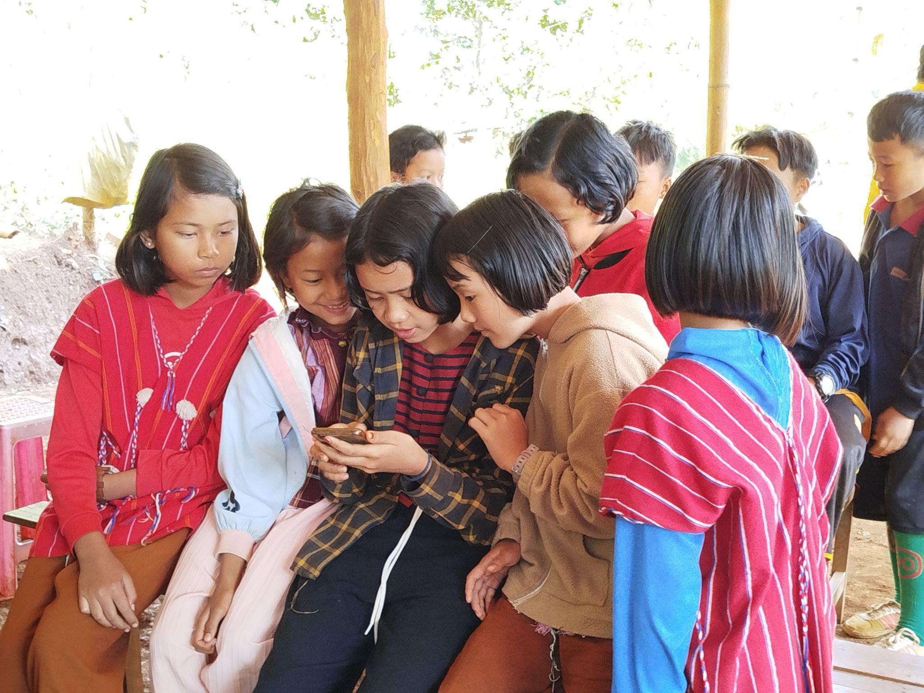
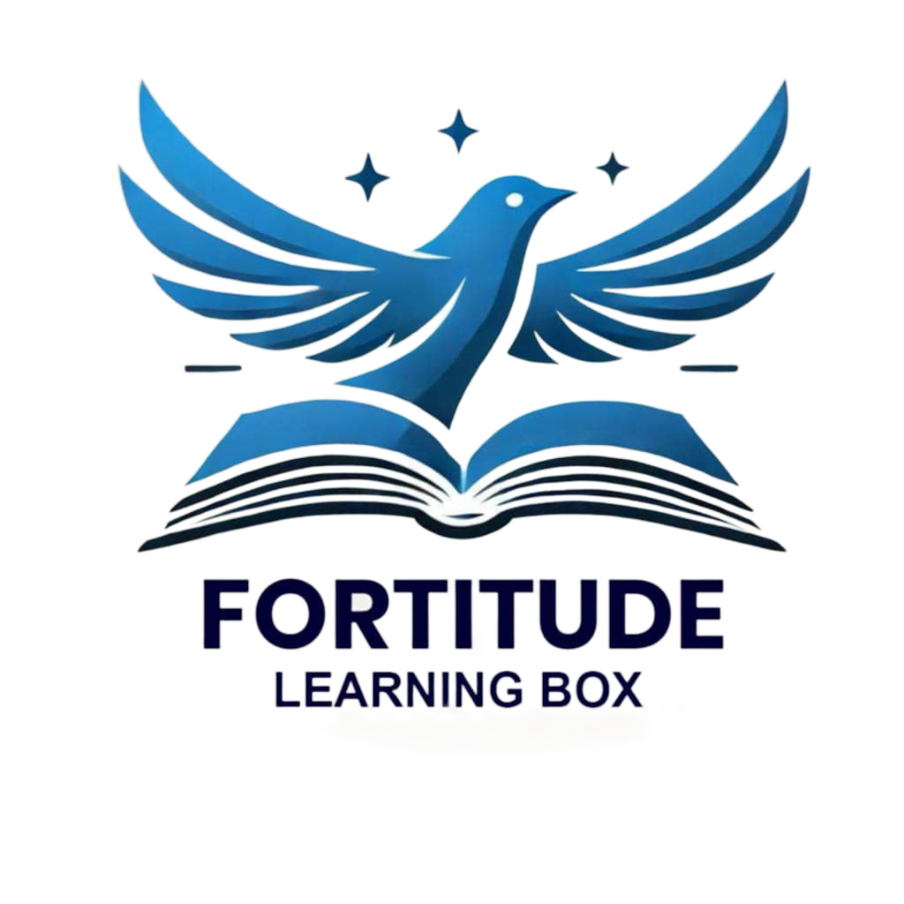

Fortitude Learning Box - FLB

Slide 2
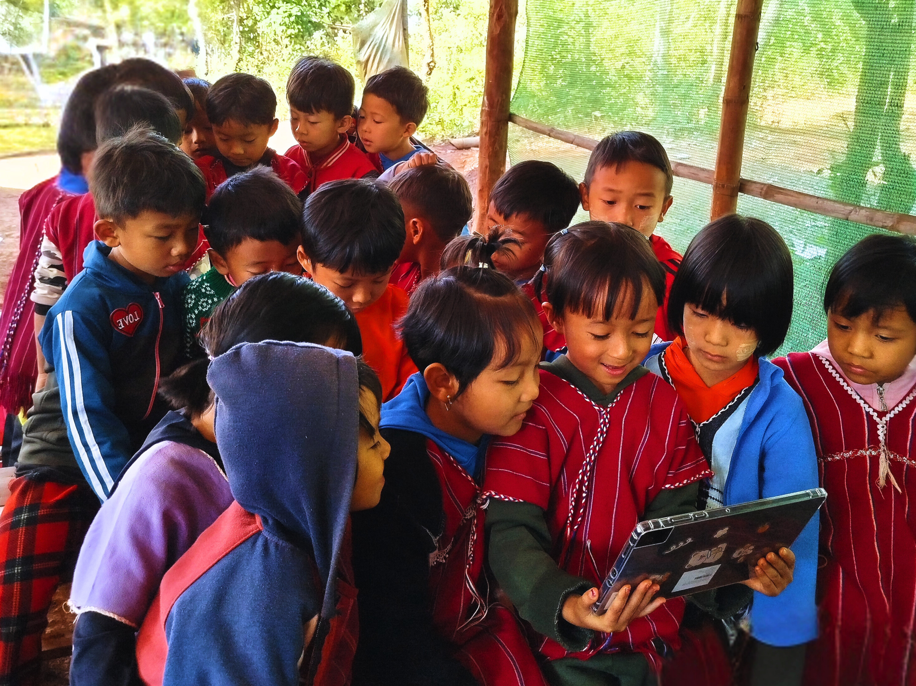
Why the Project Matters
⚡ Most of IDP children in Karenni State lack digital learning.
❌ No internet, unstable electricity in many rural communities.
📚 Interrupted schooling due to conflict & displacement.
♿ Children with disabilities face double exclusion.

Slide 3
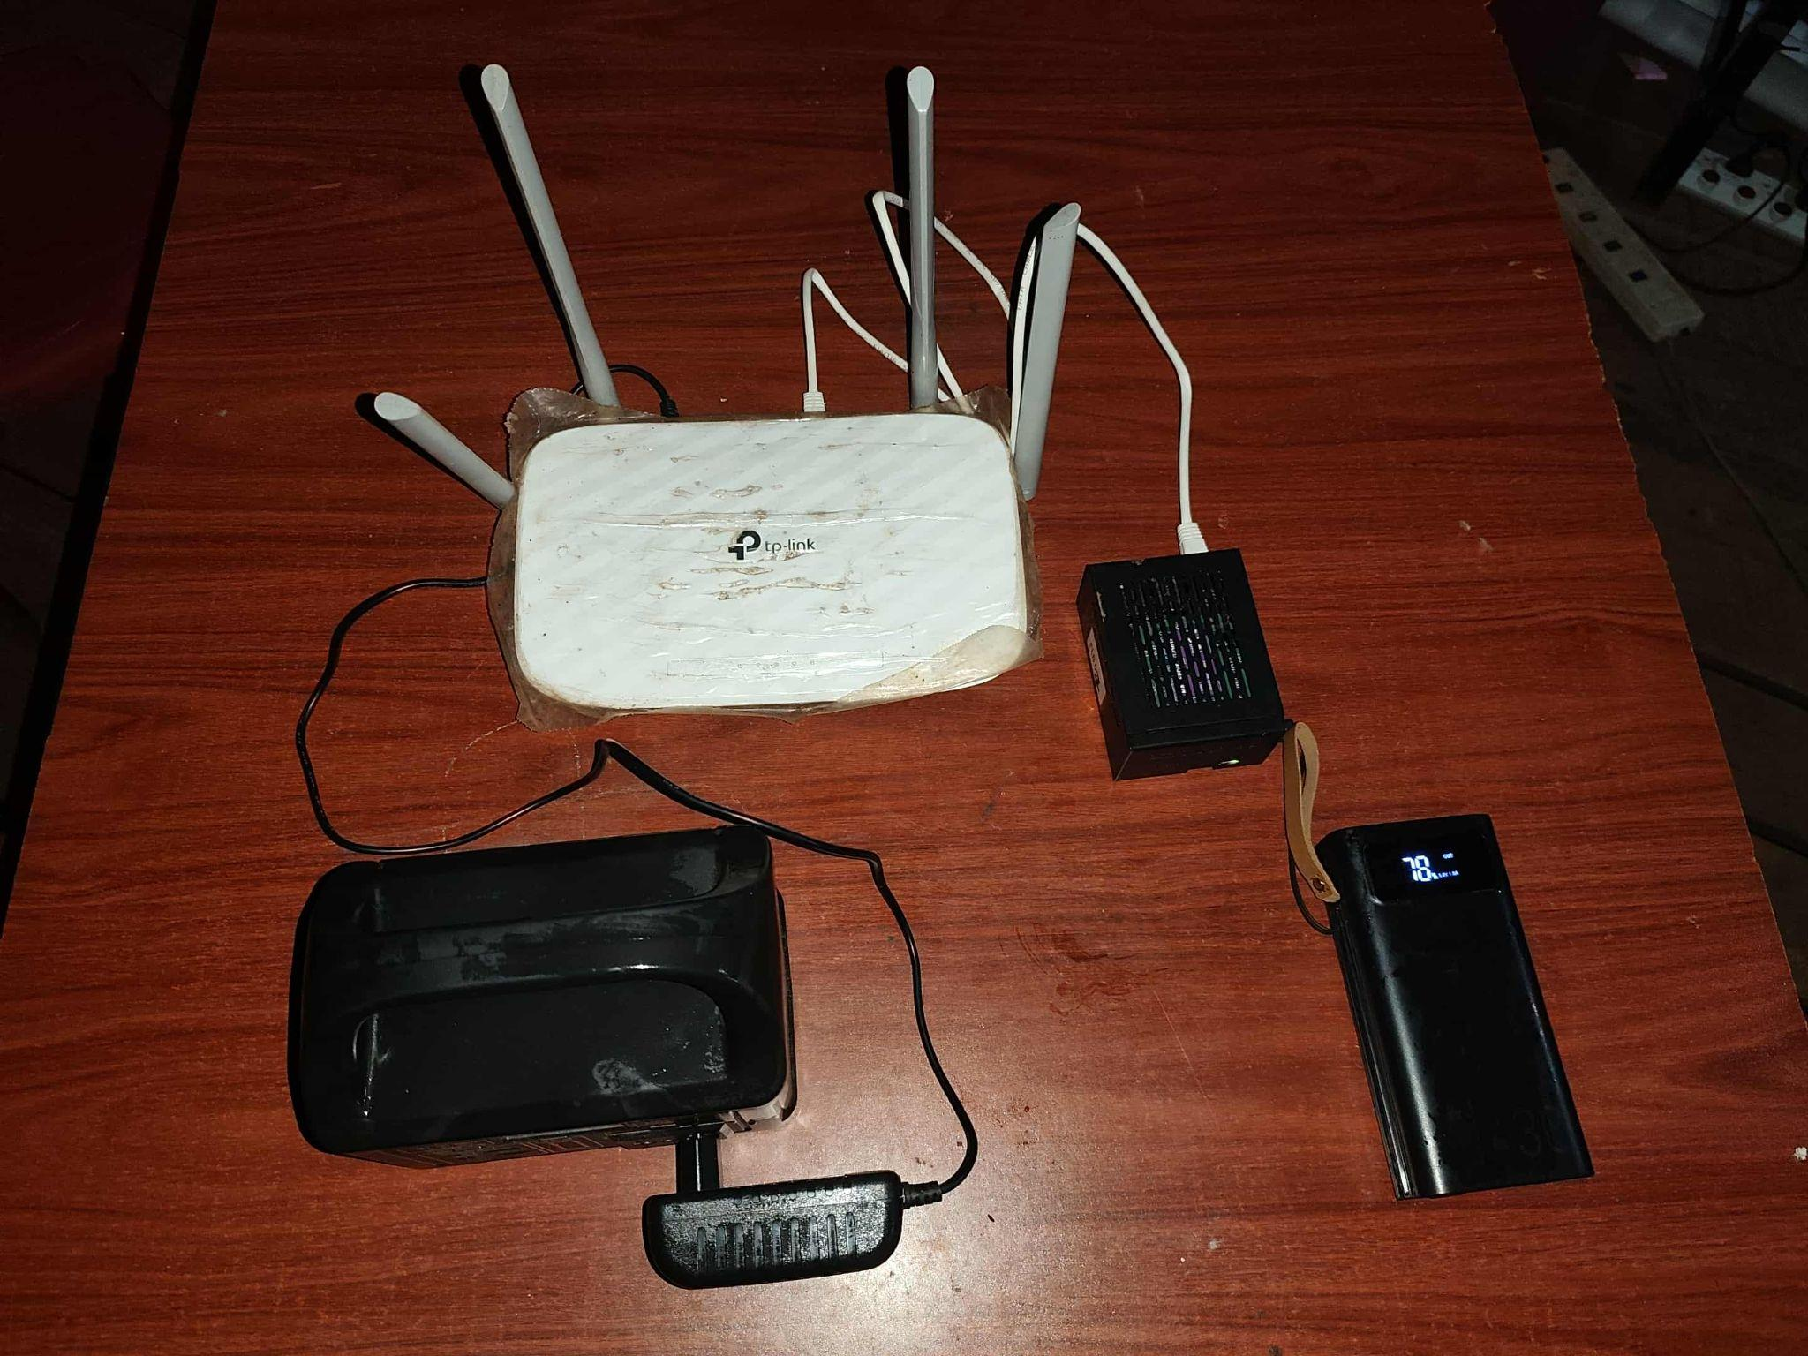
What is Fortitude Learning Box?
1.Solar-powered, mobile learning hub
2.Portable , offline and local Wi-Fi hotspot.
3.Runs on open-source Linux Technology ( Moodle LMS )
4.Adaptive & inclusive for diverse learners

Slide 4
Fortitude Learning Box -
Hardware: Raspberry Pi 5 / mini-server, SSD, solar power, router.
Software: Linux, Moodle LMS, accessibility tools.
Connectivity: Wi-Fi network for phones, tablets, laptops.
Power: Solar-powered + battery backup.
Content Delivery: Digitized curricula + multimedia library.
Support : 50+ users concurrently

Slide 5
Educational Content
Core Curriculum (Grades 1–12) → FED and partners digitized courses
Specialized Training: Trauma-informed teaching, psychosocial counseling, disability awareness, EORE, GBV, and safe migration.
Digital Library & Media: Audiobooks, offline PDFs, podcasts, videos.
AI Empower : It will be part of sustainable plan

Slide 6
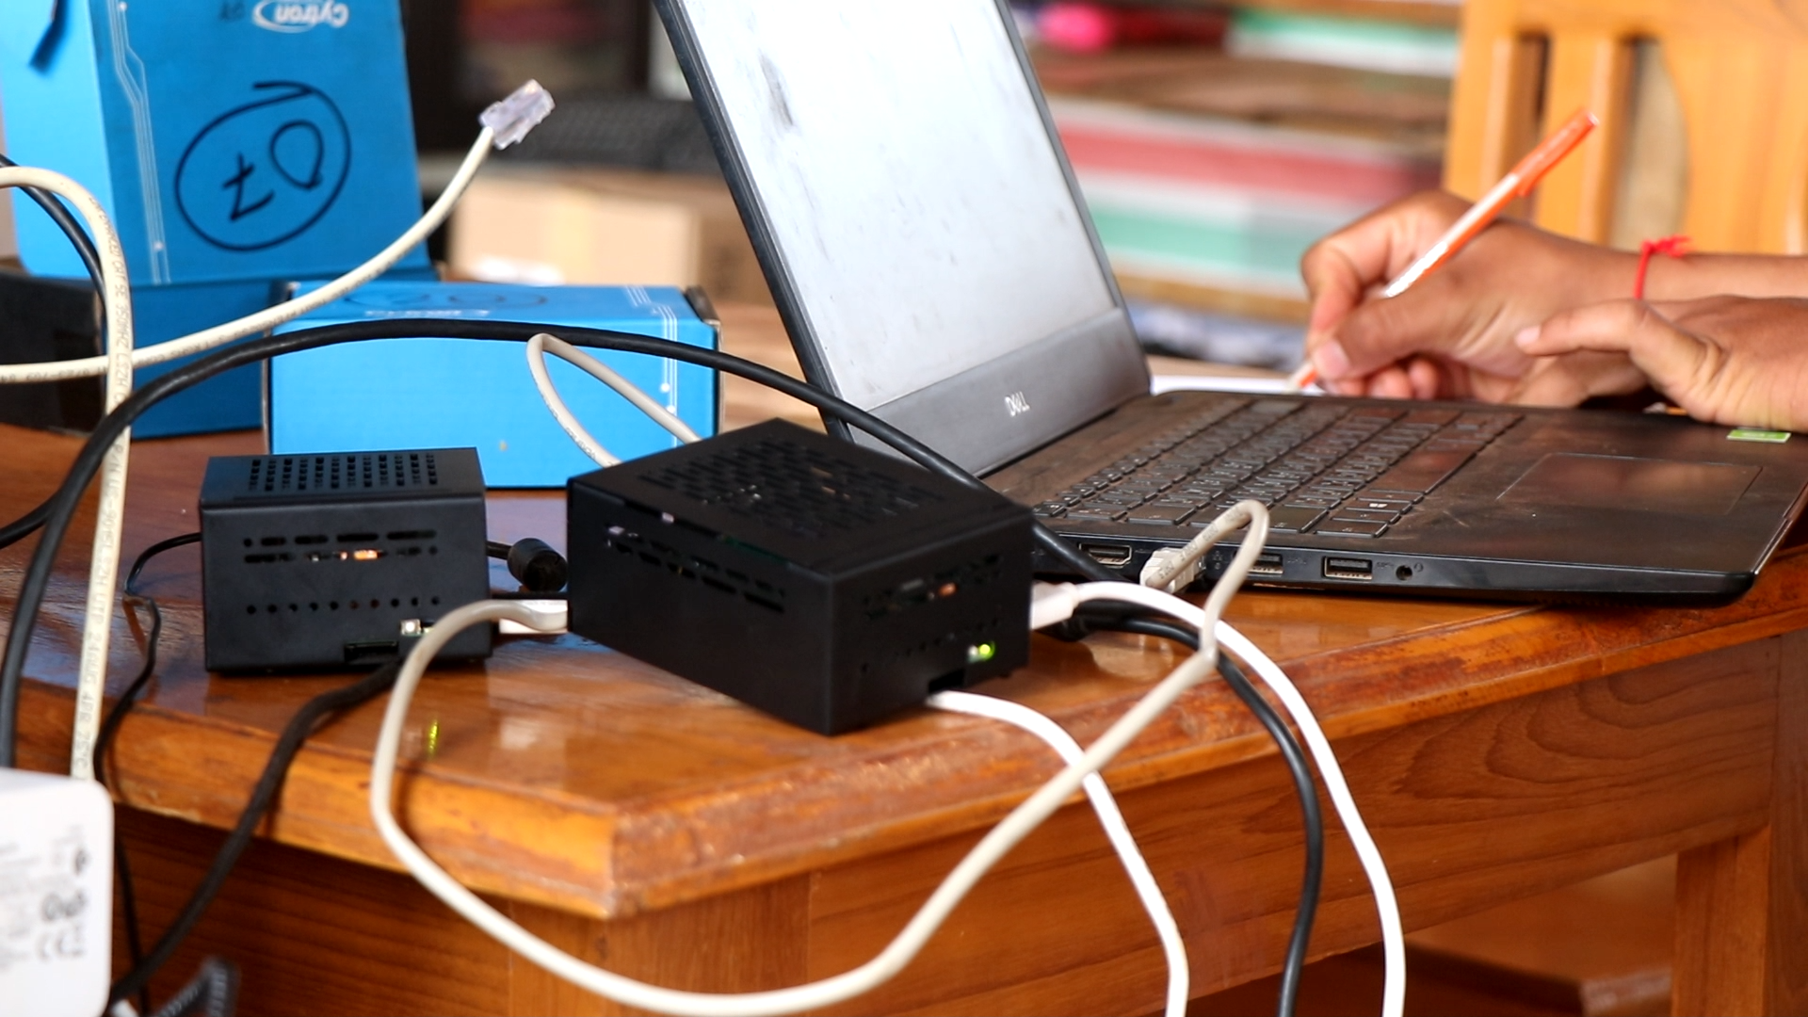
Hardware components
Raspberry PI 5 Model B
Random Access Memory - 8 GB
Solid State Drive ( SSD) - 256 GB
Network port + WIFI enabled
Customized Heat Sink and Airflow design
Metal Case with damage sensitivity environment
Robust Storage Design with SSD
Wireless Router ( dual band support )
Network cables for local wiring
Power station

Slide 7
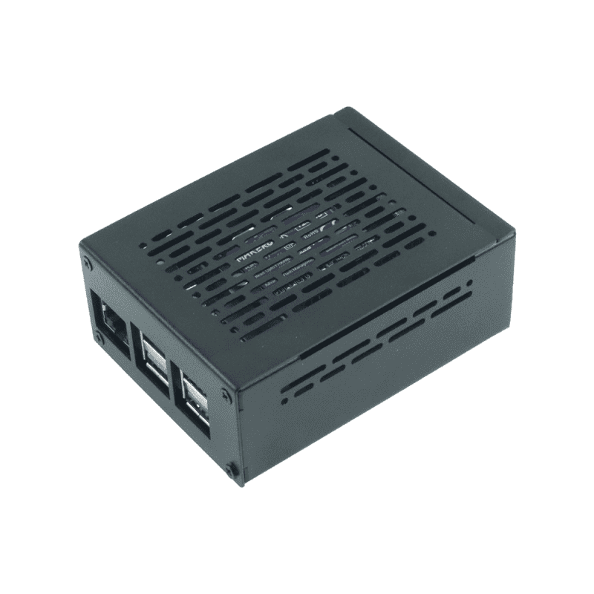
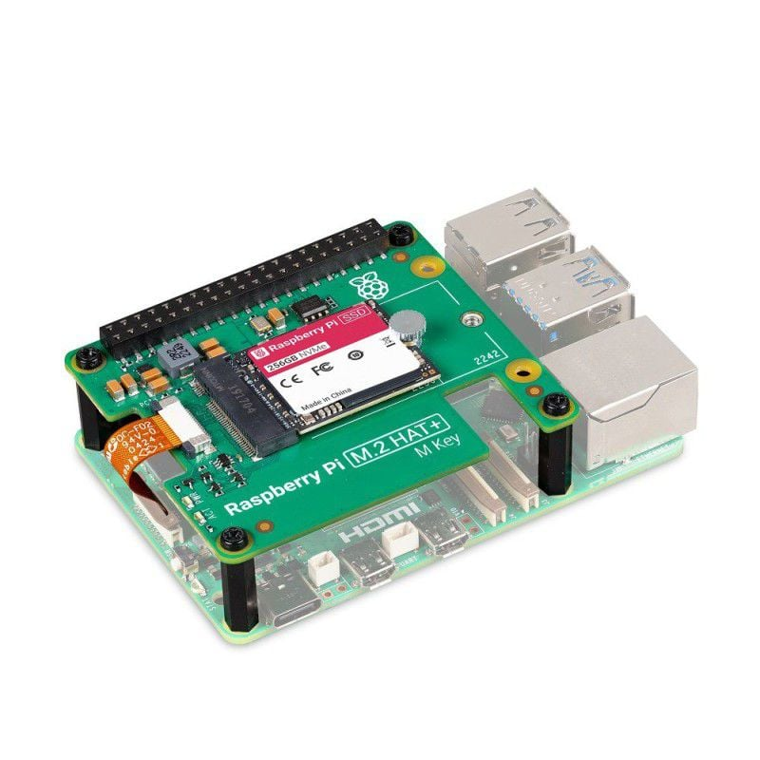
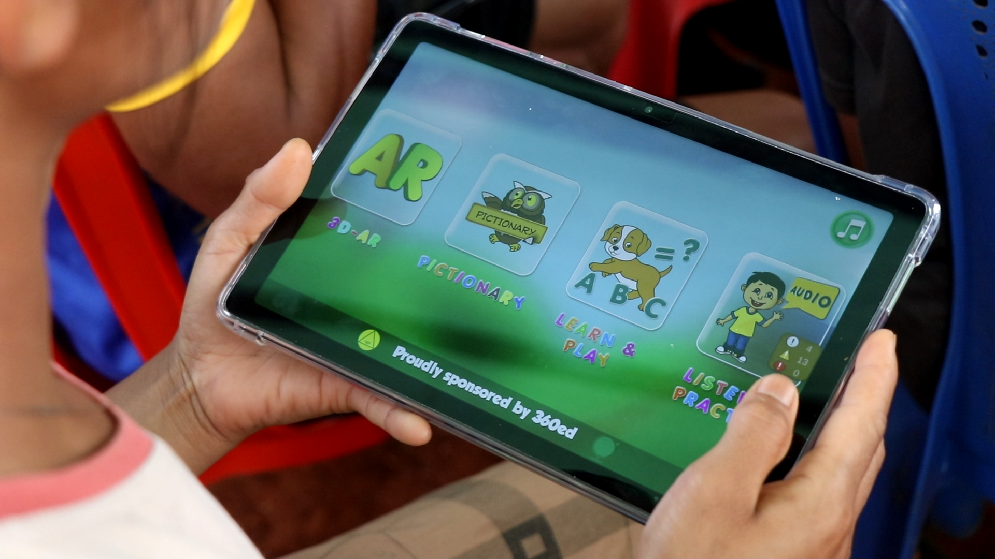
Hardware components
Computer Board With SSD 256GB
Metal Case
Tablets

Slide 8
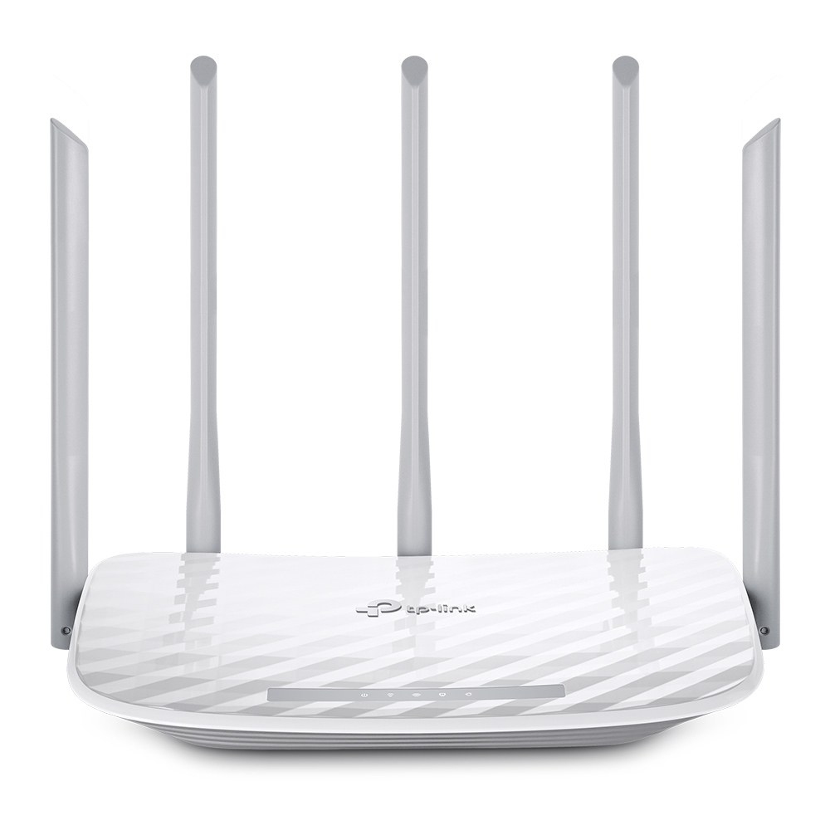
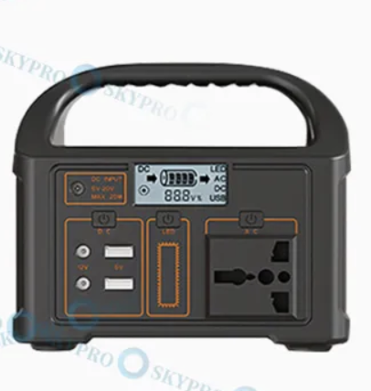
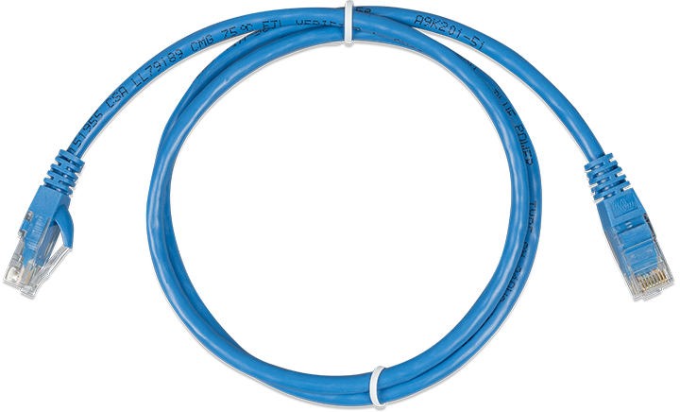
Hardware Components
TP-Link Router
Power Station
Network Cables

Slide 9
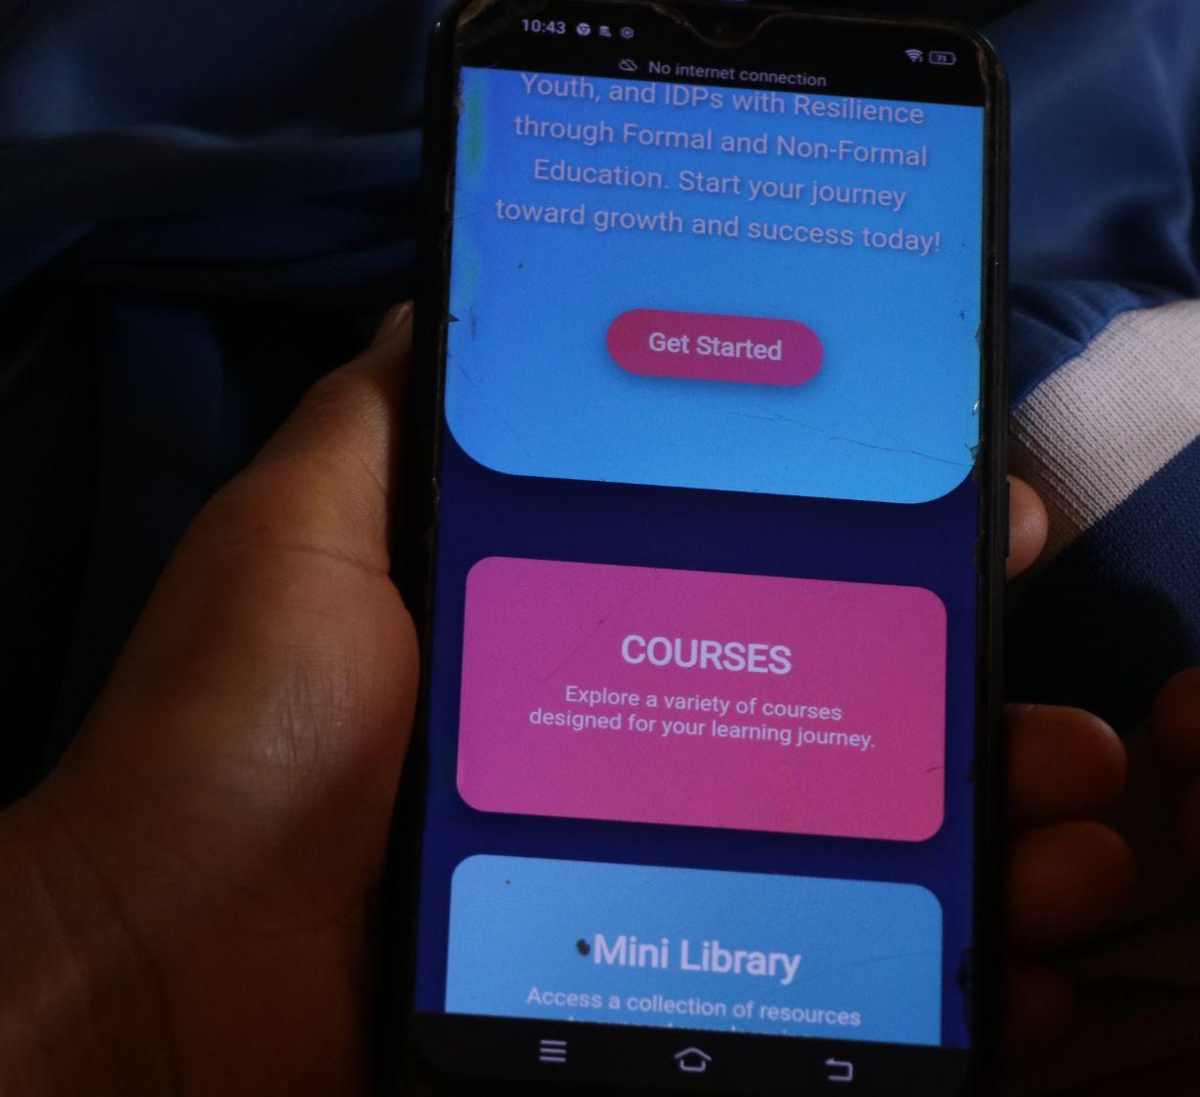
Software components
Open Source Technology - Linux based OS
Docker based image are running on Raspberry PI
Including moodle , calibre , audio book
Enhancing home landing page for easier access

Slide 10
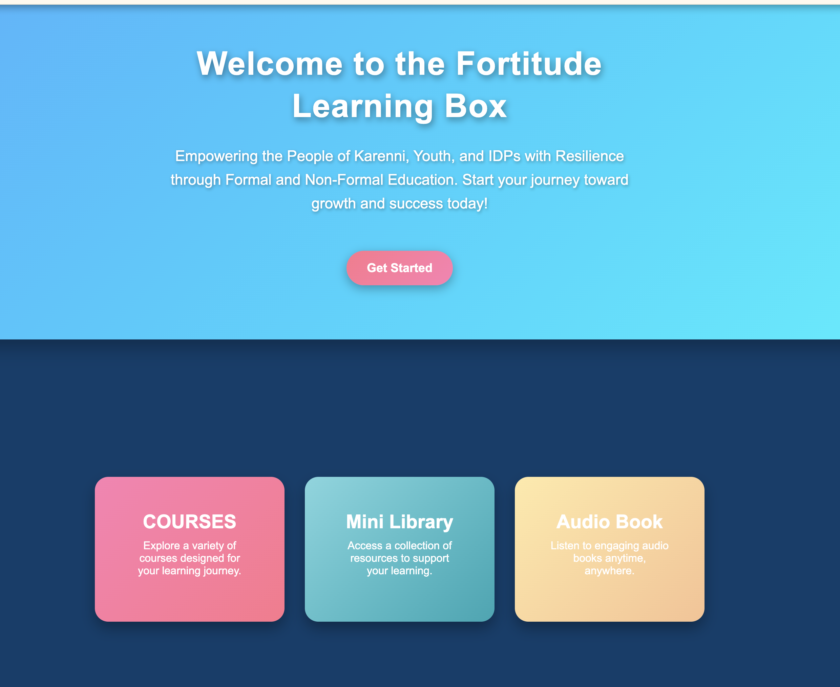
Software Components
COURSES
Mini Library
Audio Book

Slide 11
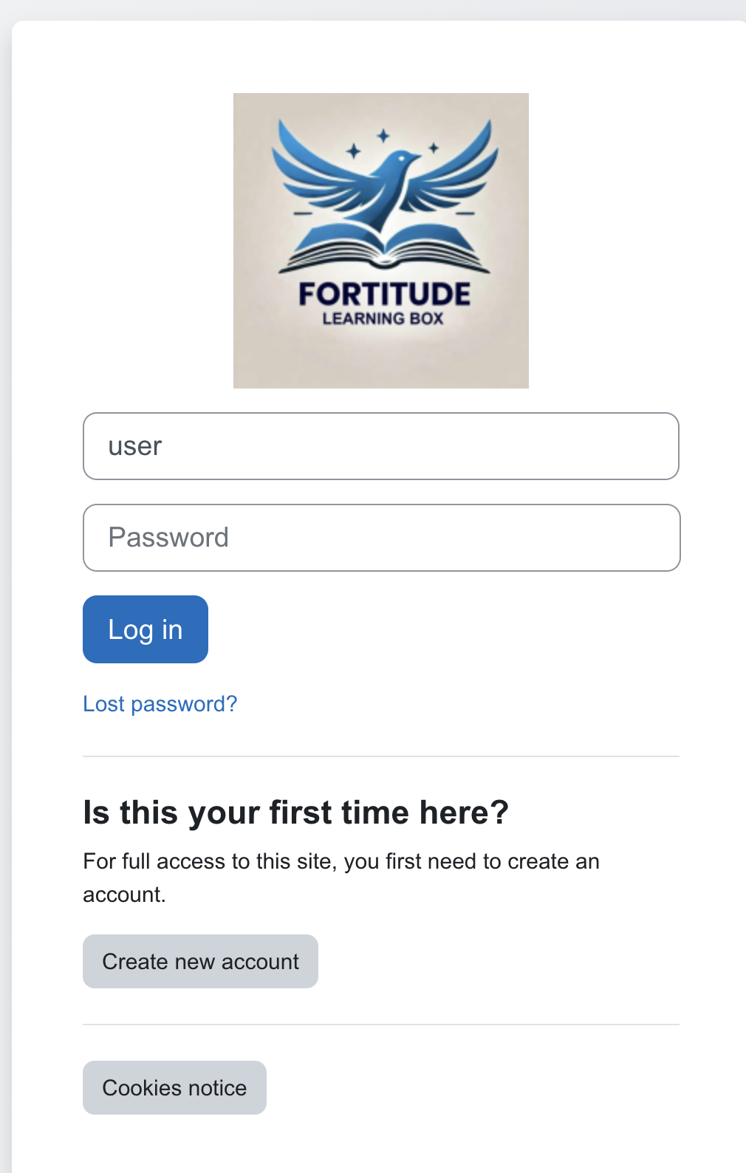
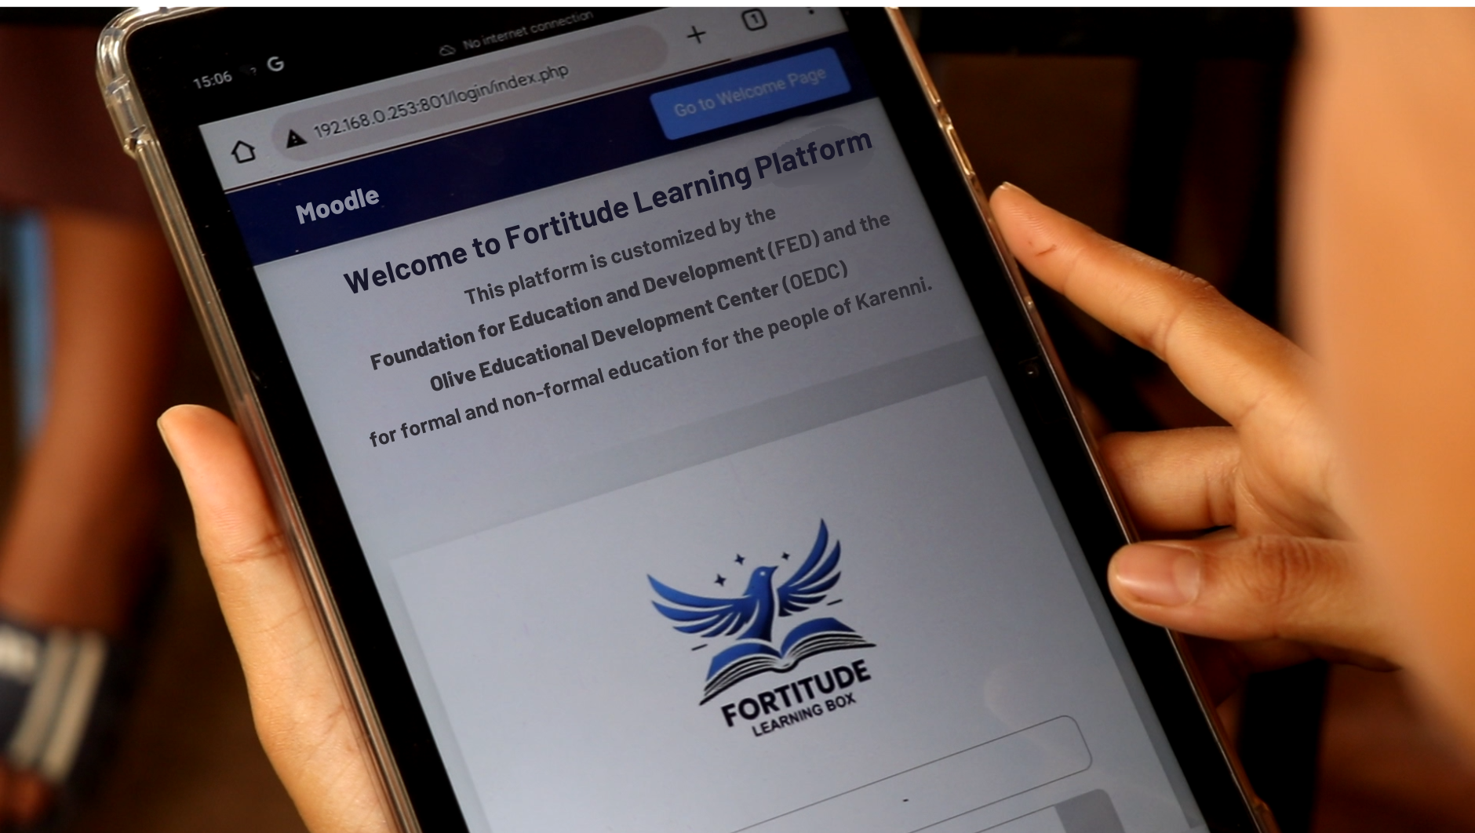
COURSES - Moodle
Mobile View
Tablet Views

Slide 12
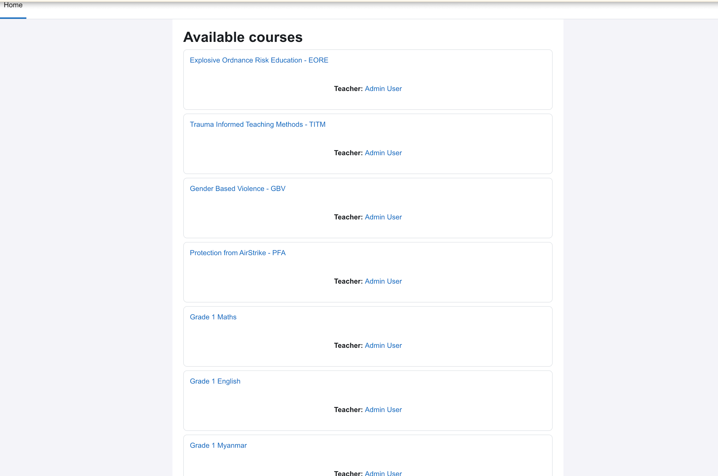
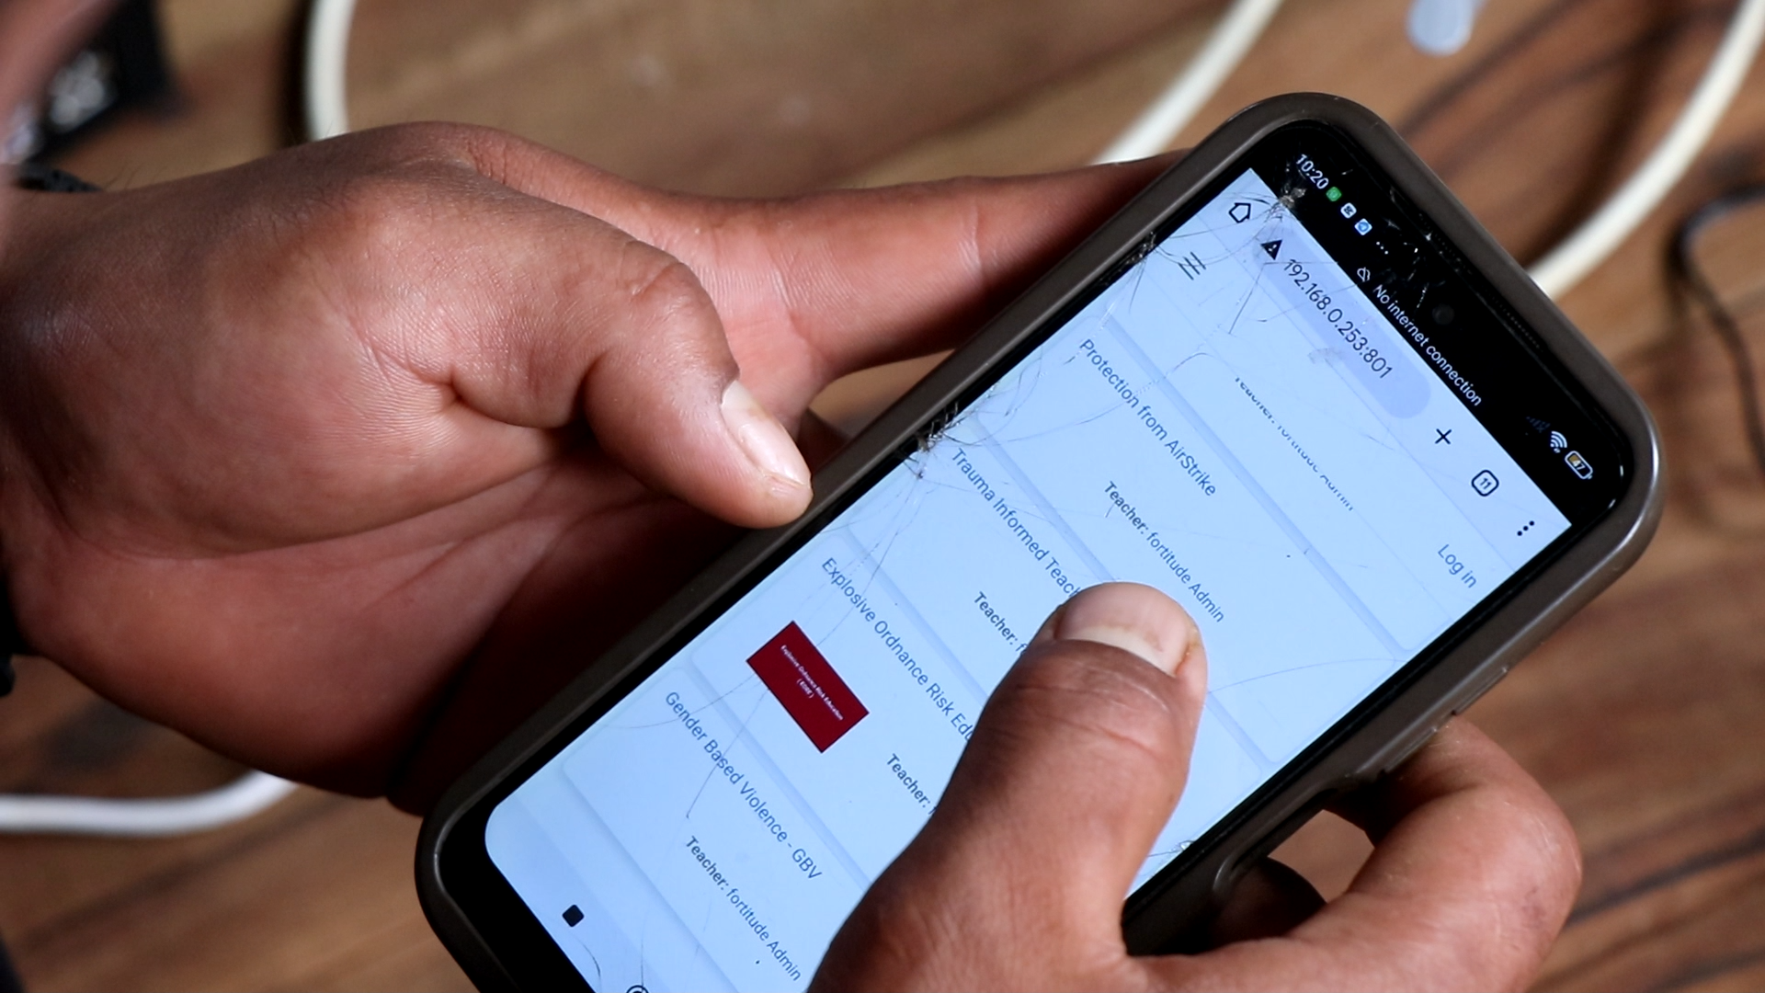
COURSES - Moodle
COURSE - Moodle

Slide 13
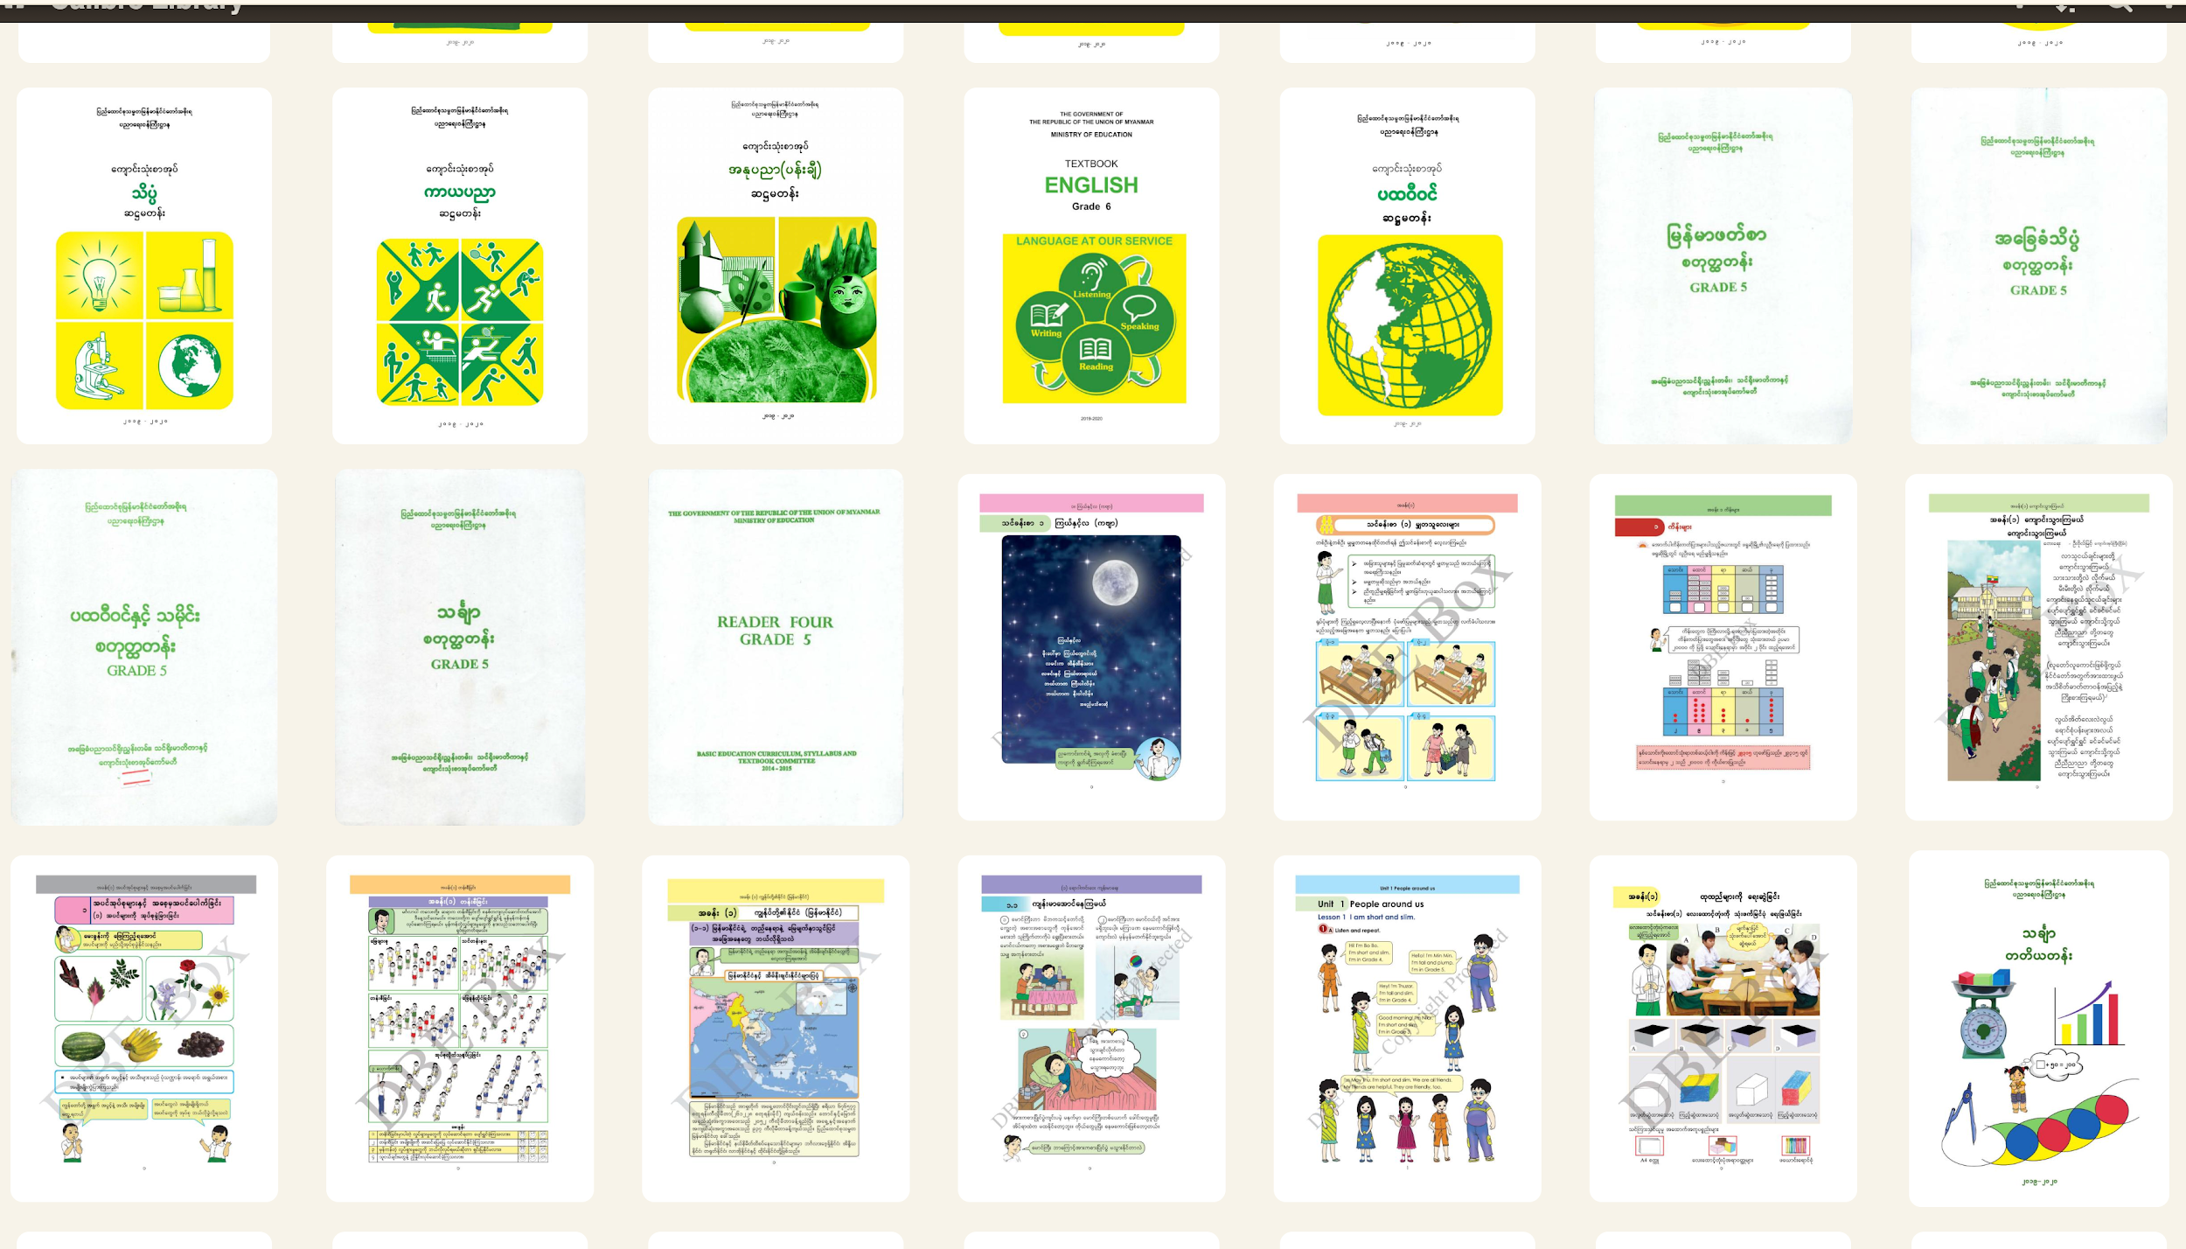
Mini Library
Grade 1 - 12 Textbook
Agricultural
Comic
Health
Livestock
Technology
English Textbook , etc

Slide 14
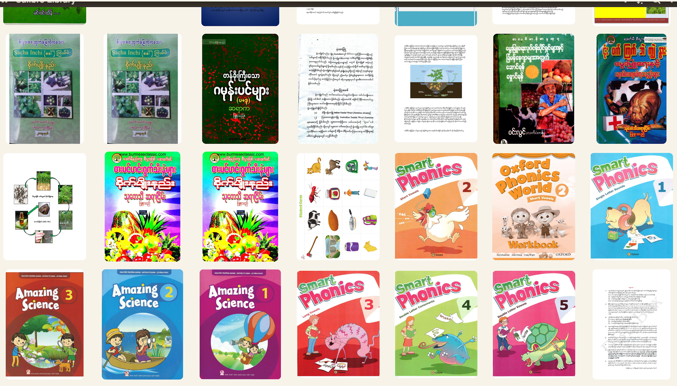
Mini Library

Slide 15
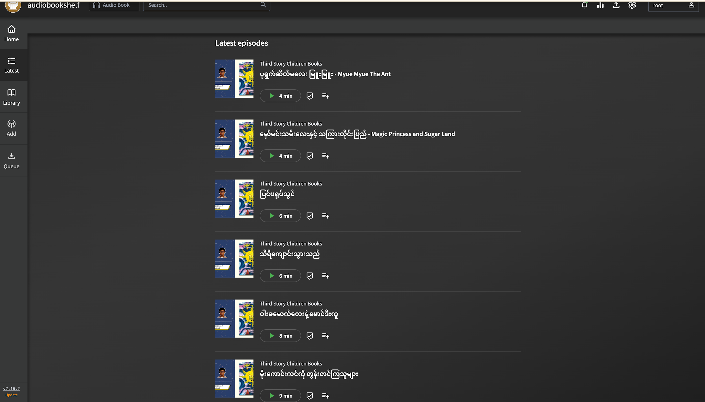
Audio Book
Story for Kids
English Songs
Local News
Educational support songs
Worship songs
Motivations speaking

Slide 16
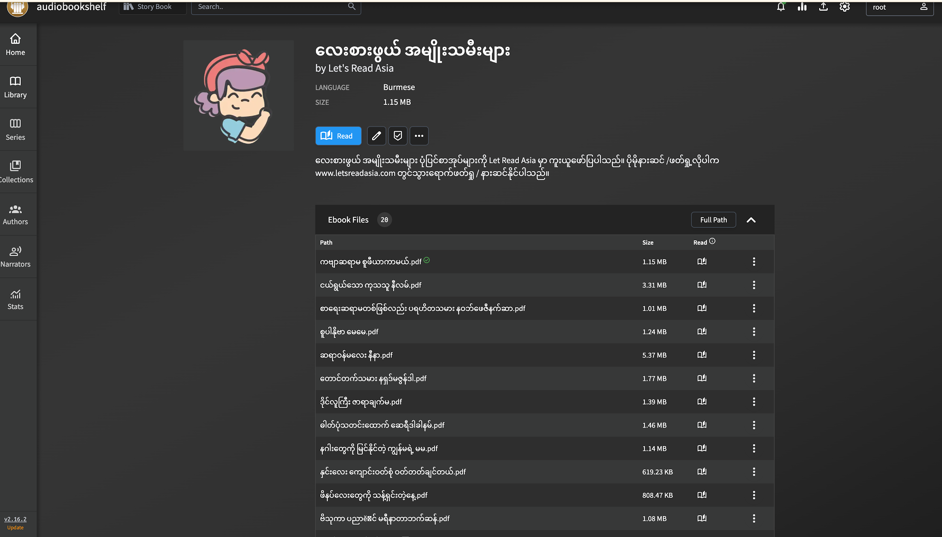
Audio Book

Slide 17
Our Project Impact
STUDENTS
PLACES
Schools
1200+
20
20+
CITIES
Facilitators
VOLUNTEERS
3
20
50+

Slide 18
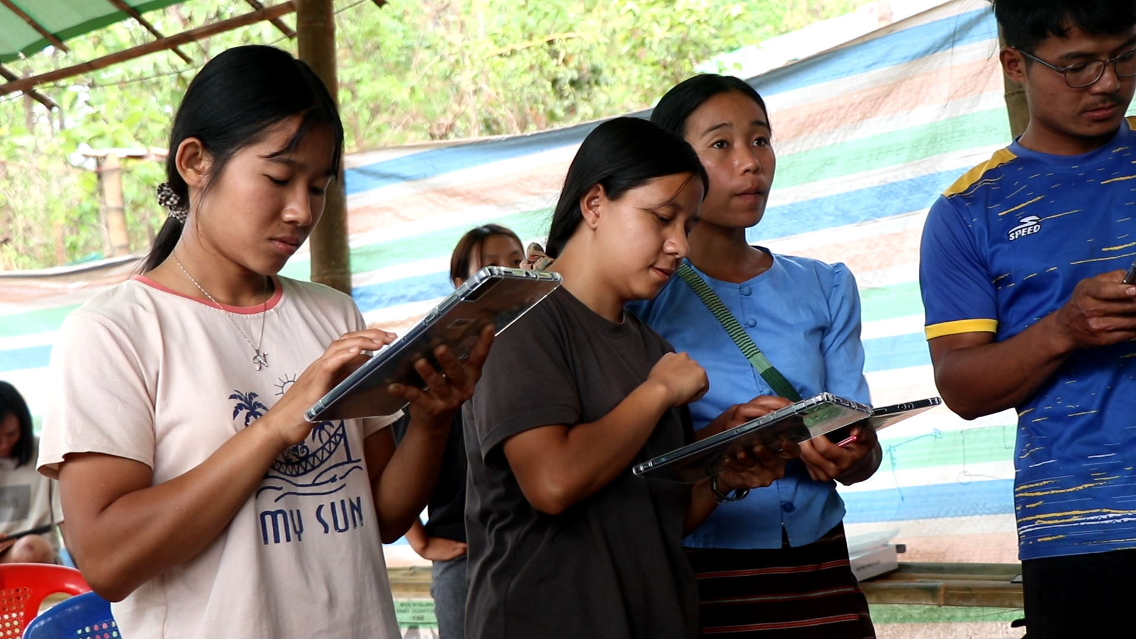
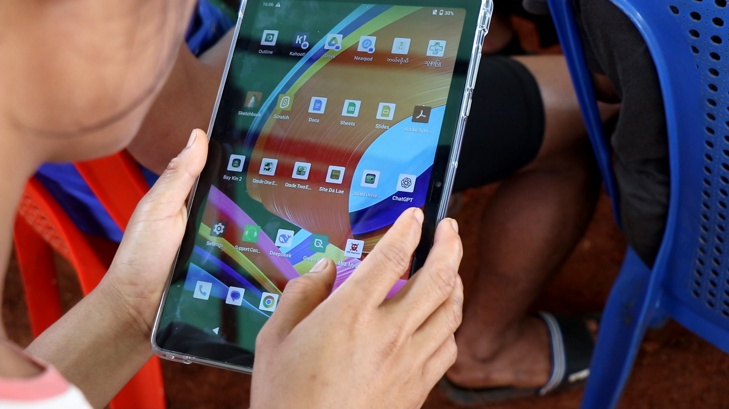
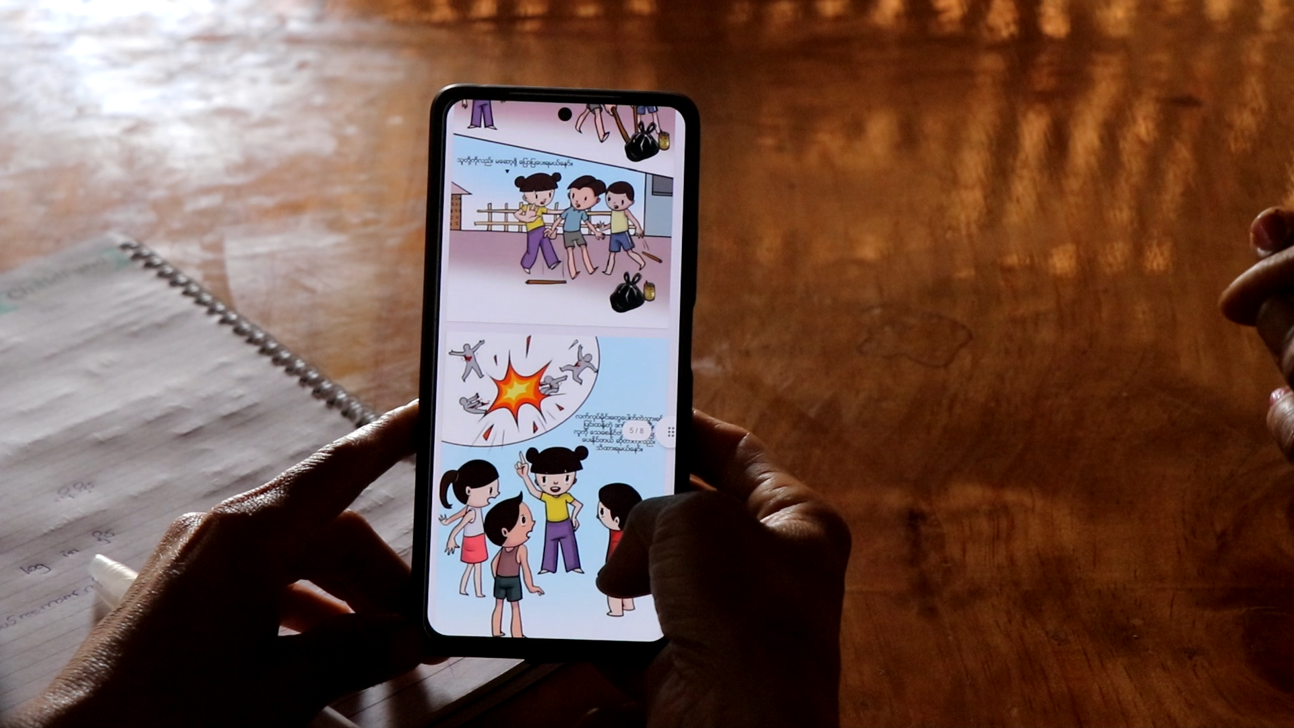
Our Impact Highlight

Slide 19
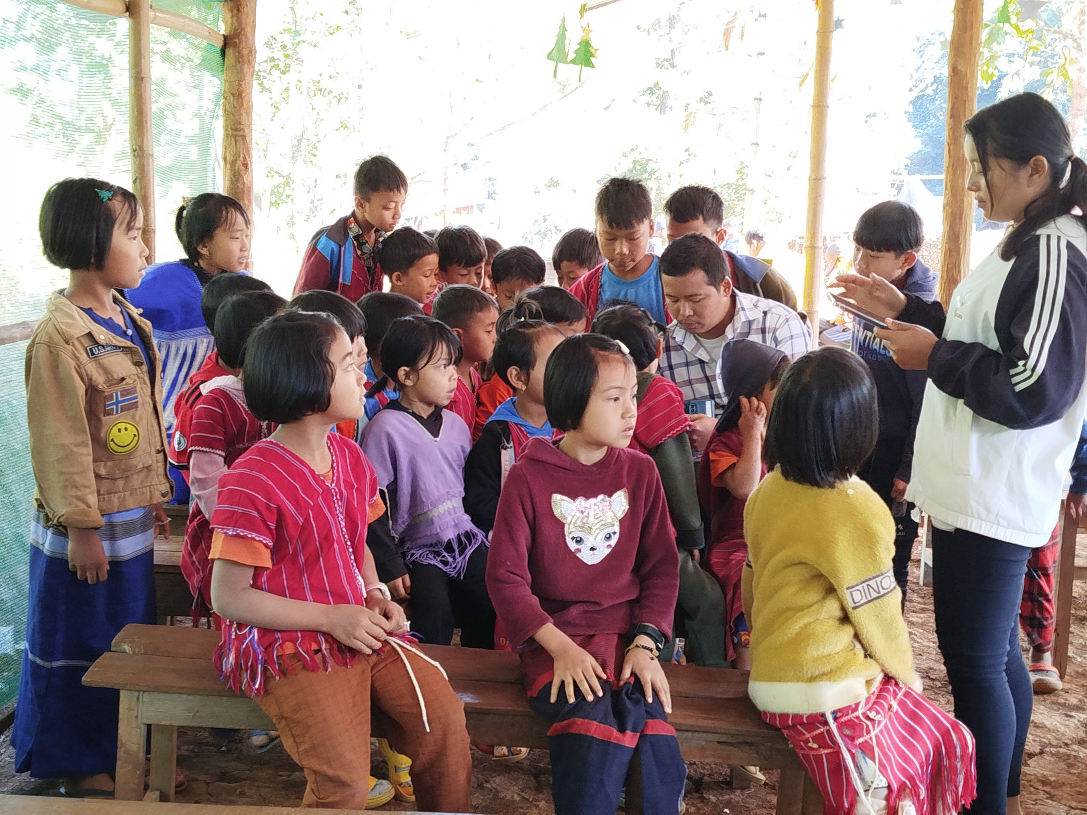
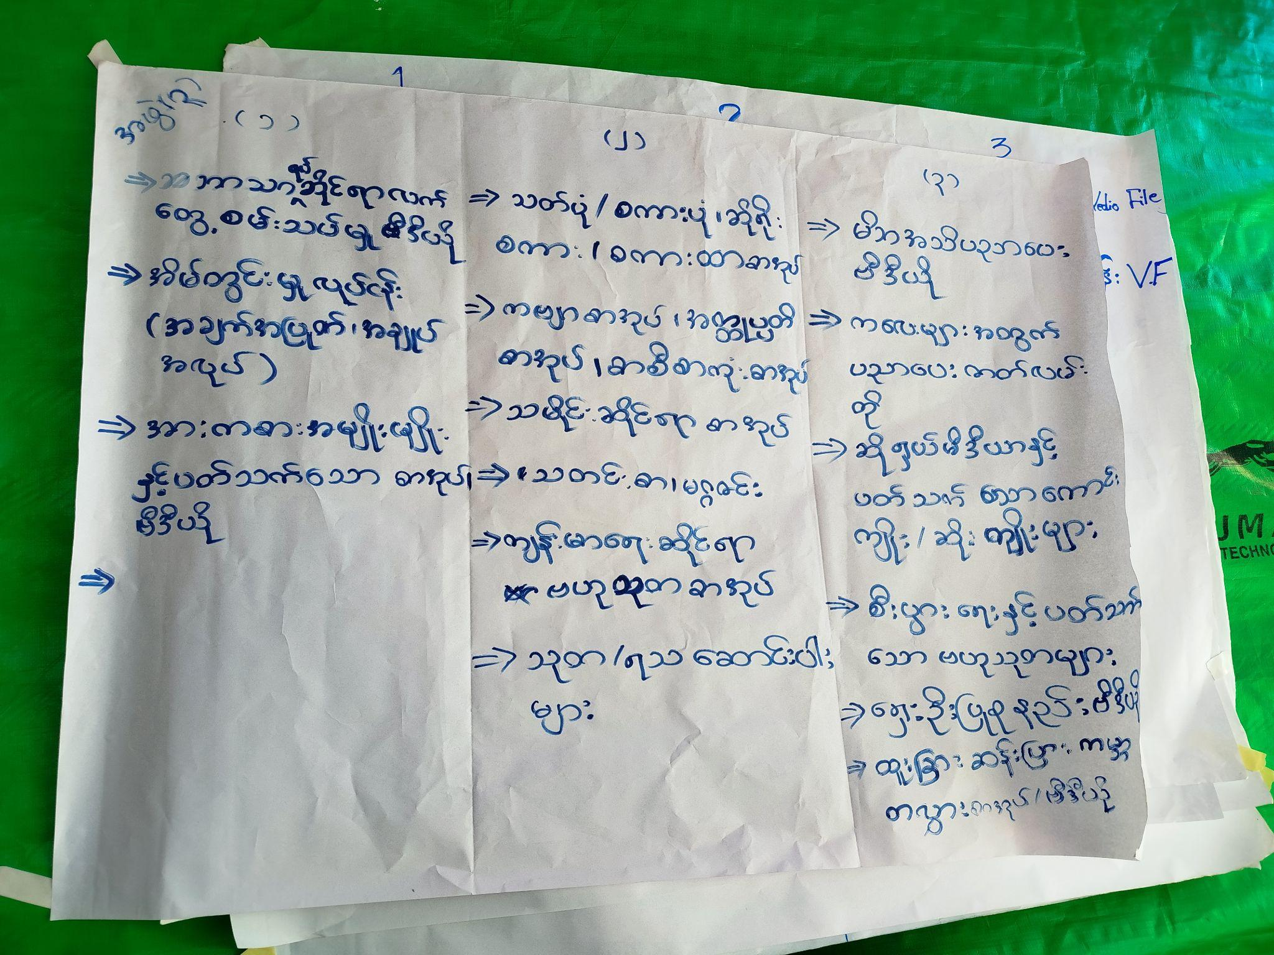
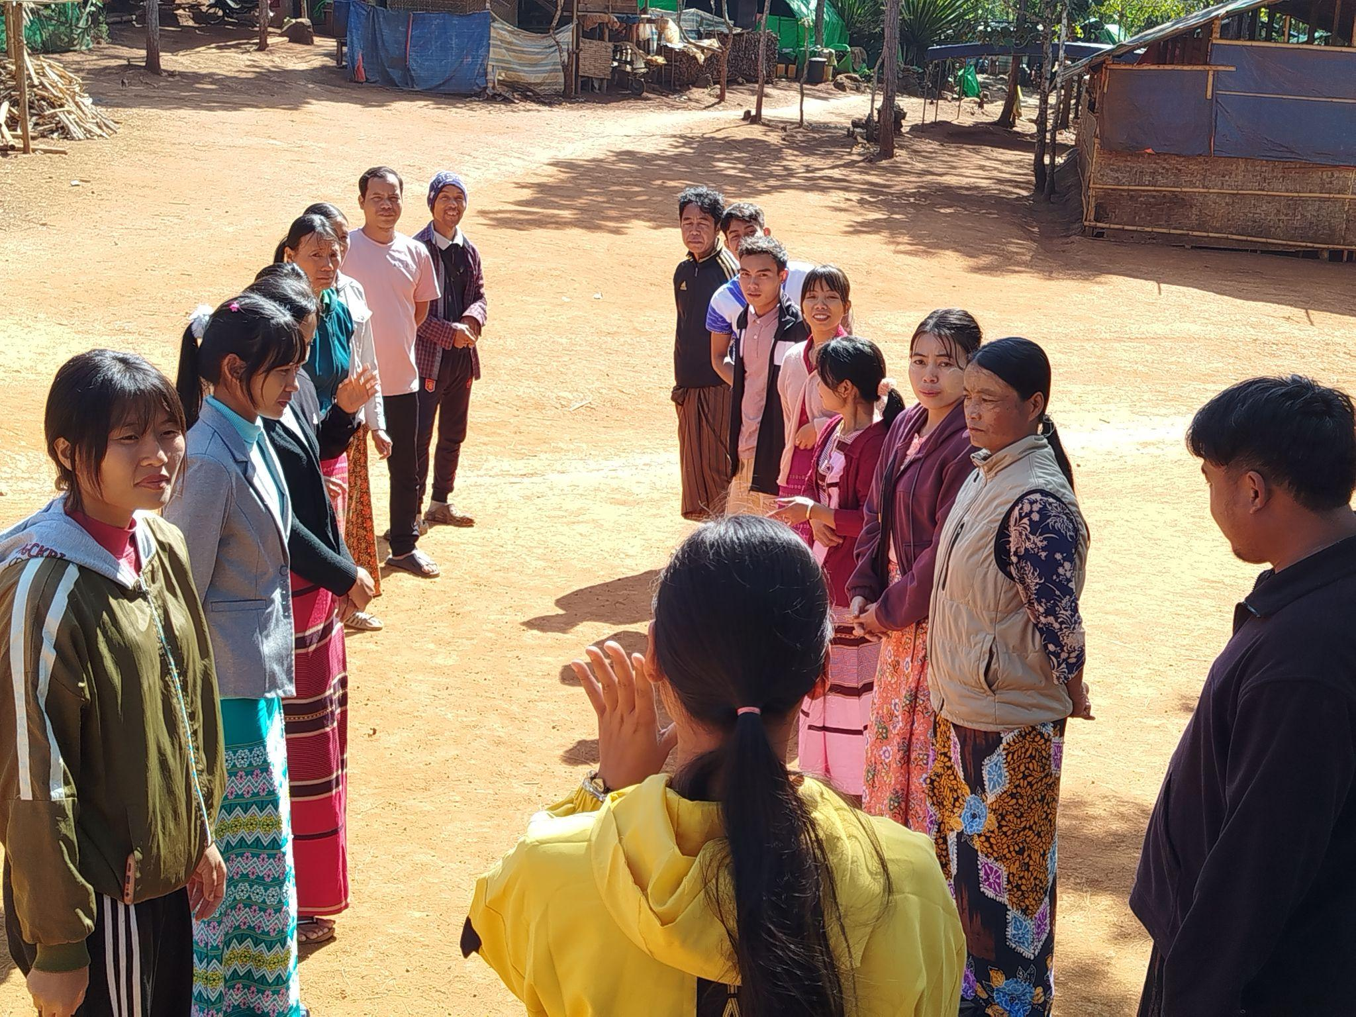
Our Impact Highlight

Slide 20
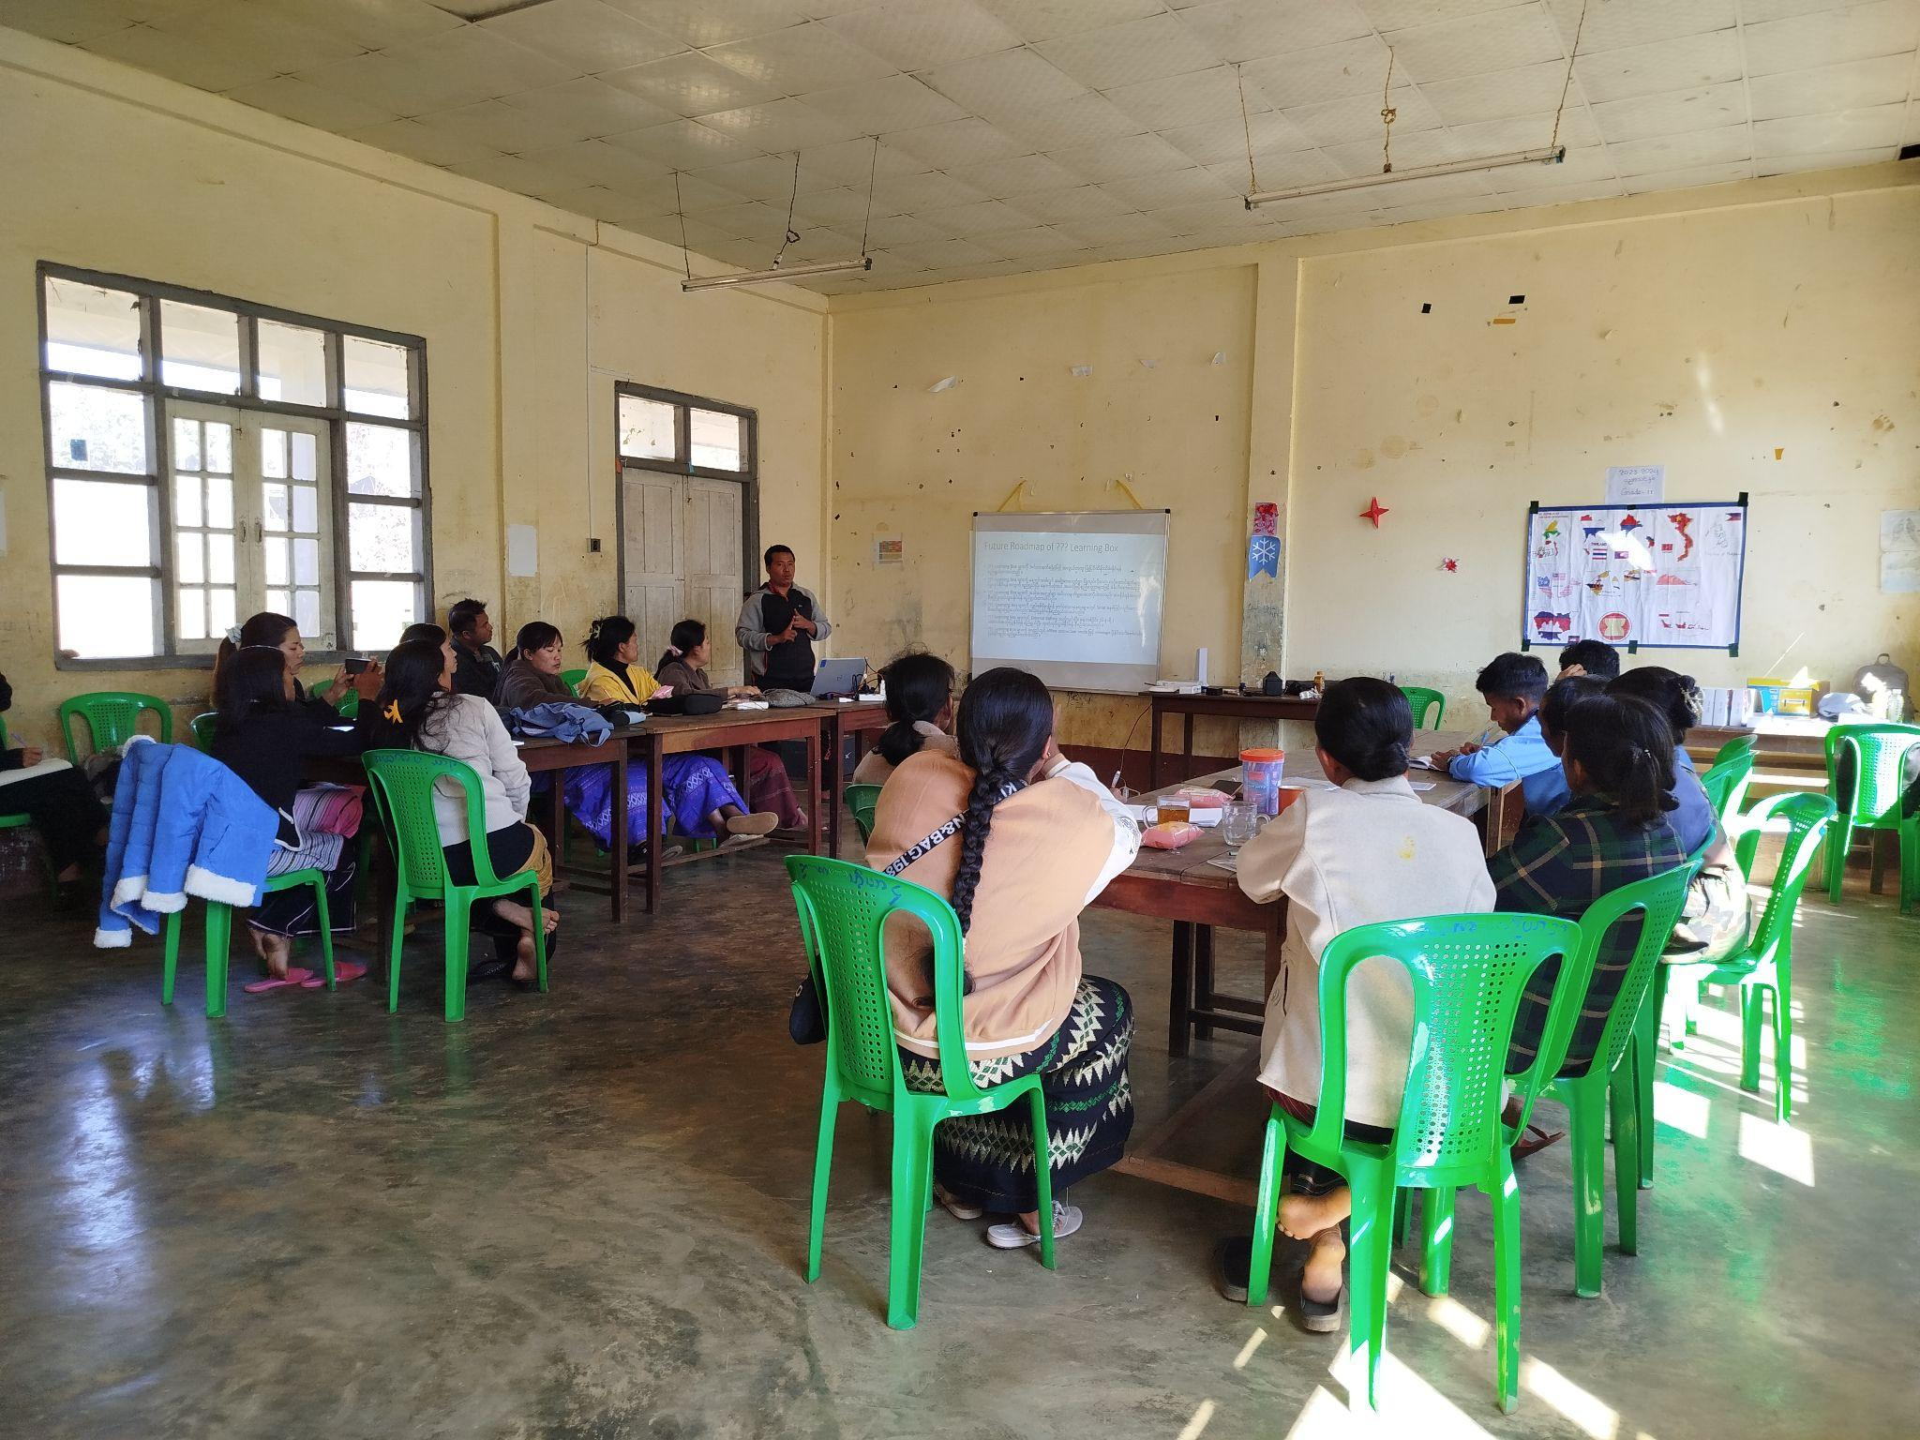
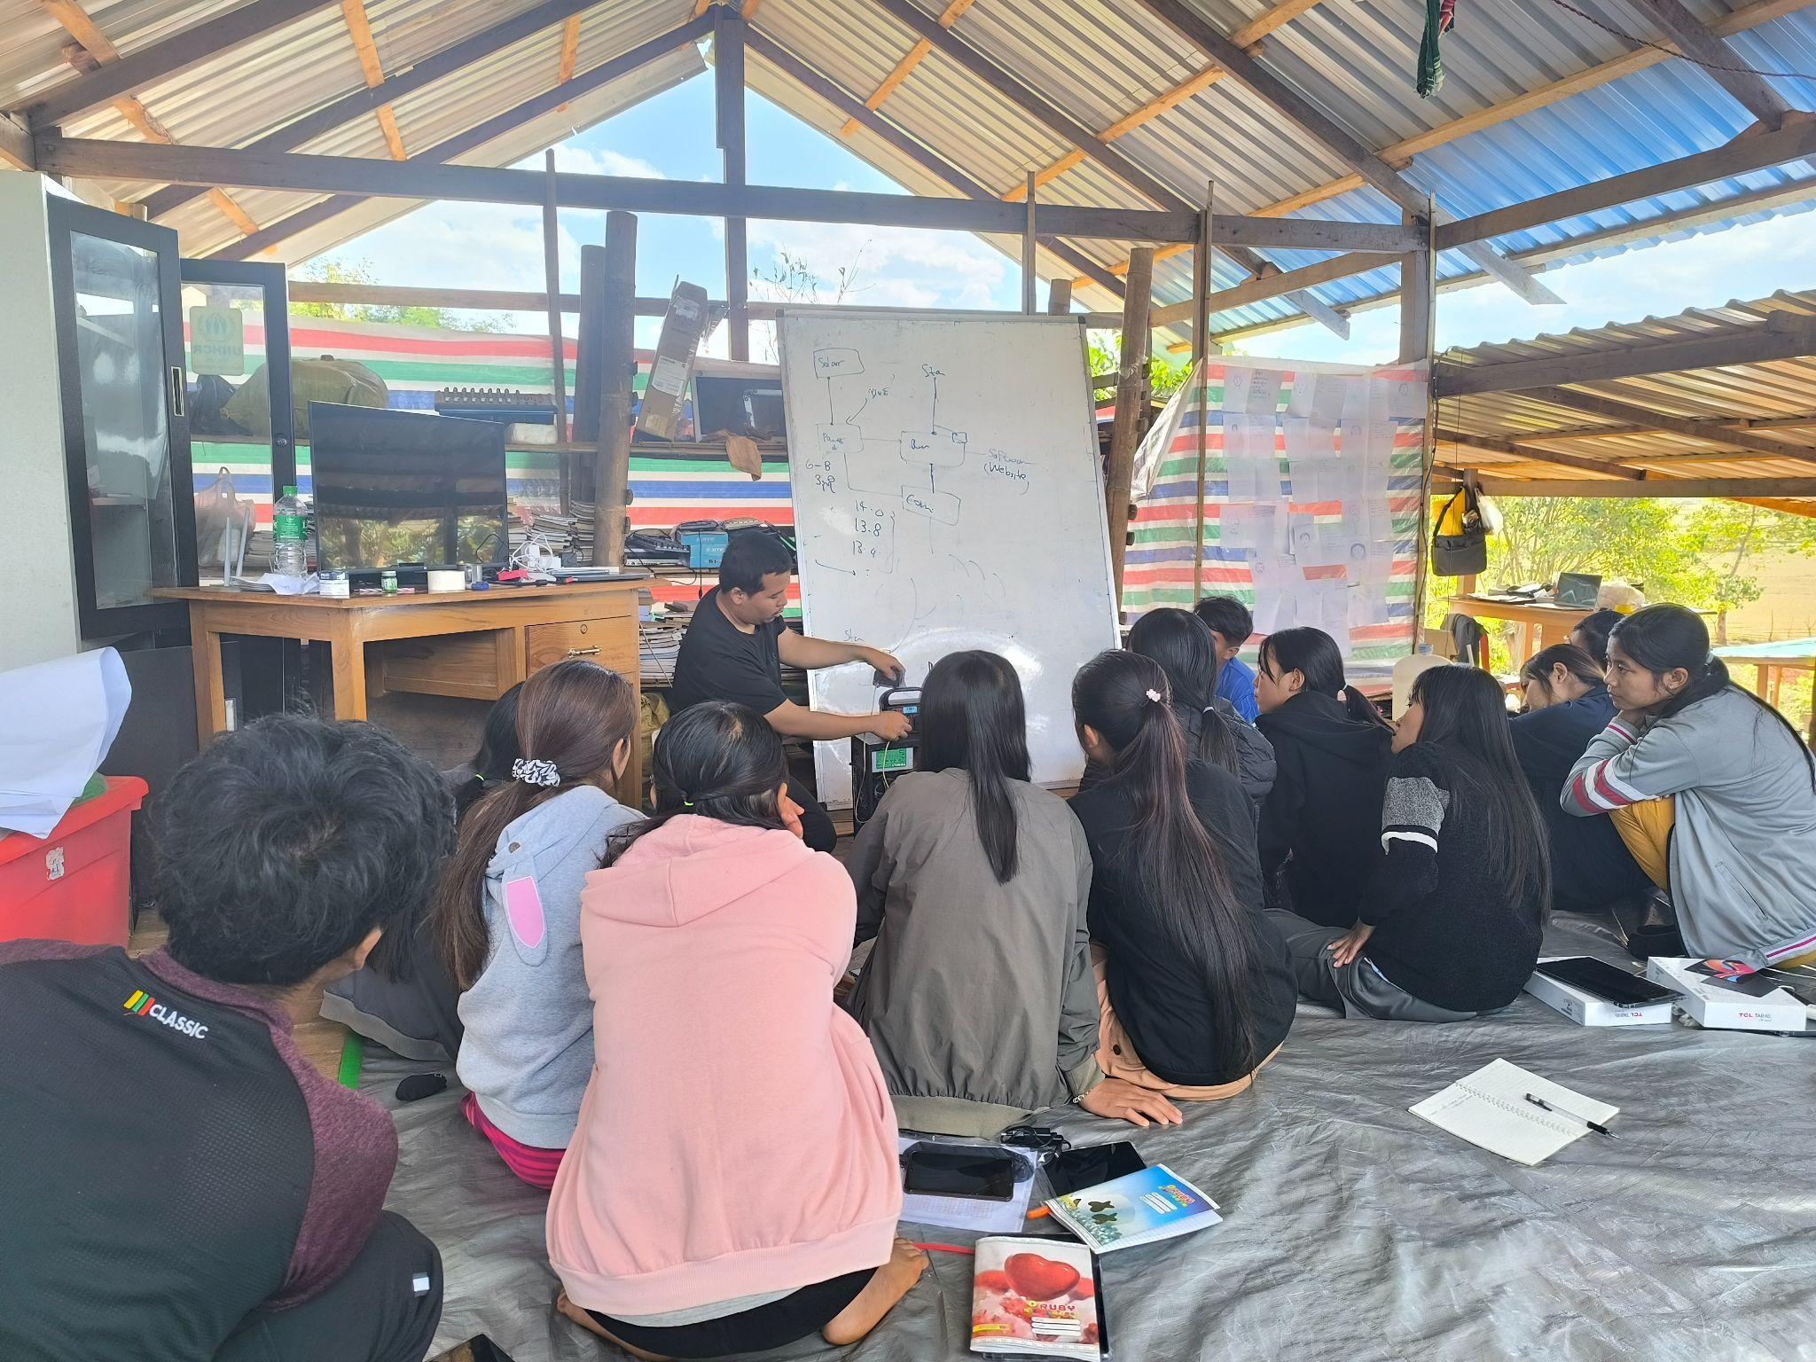
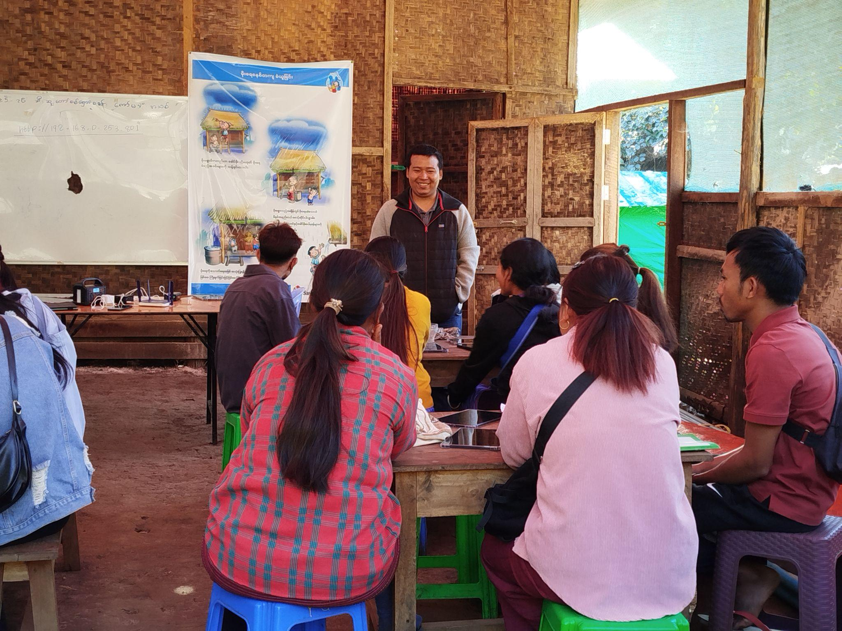
Volunteer and Facilitator Training

Slide 21
Sustainability
Open-source, low-cost hardware & software.
Renewable energy (solar).
Local volunteer & teacher training.
Community co-management model.

Slide 22
Where We’re Going Next ( Sustainable Plan )
🌐 Content localization in minority languages
🤝 Partnerships with FED & 360ed for curriculum + apps
📦 Expand FLB offline system with more community content
🎙️ Community podcasts (Karenni + Burmese)
🤖 Offline AI Assistant (LLM trained on local content)
📚 Structural Curriculum Growth:
Karenni Basic Education Courses
Youth Empowerment & Peacebuilding programs
English Language Series (Beginner–Intermediate)
Grade 12 Exam Prep Toolkit

Slide 23
Toward a Structured & Scalable System
Technical Enhancements
Single Sign-On, interactive dashboards, quiz
Search & filter across PDFs, videos, audios
Offline optimization for more users
Organizational Growth
Community training manuals & feedback loops
Content Governance: local review committees + bi-annual updates

Slide 24
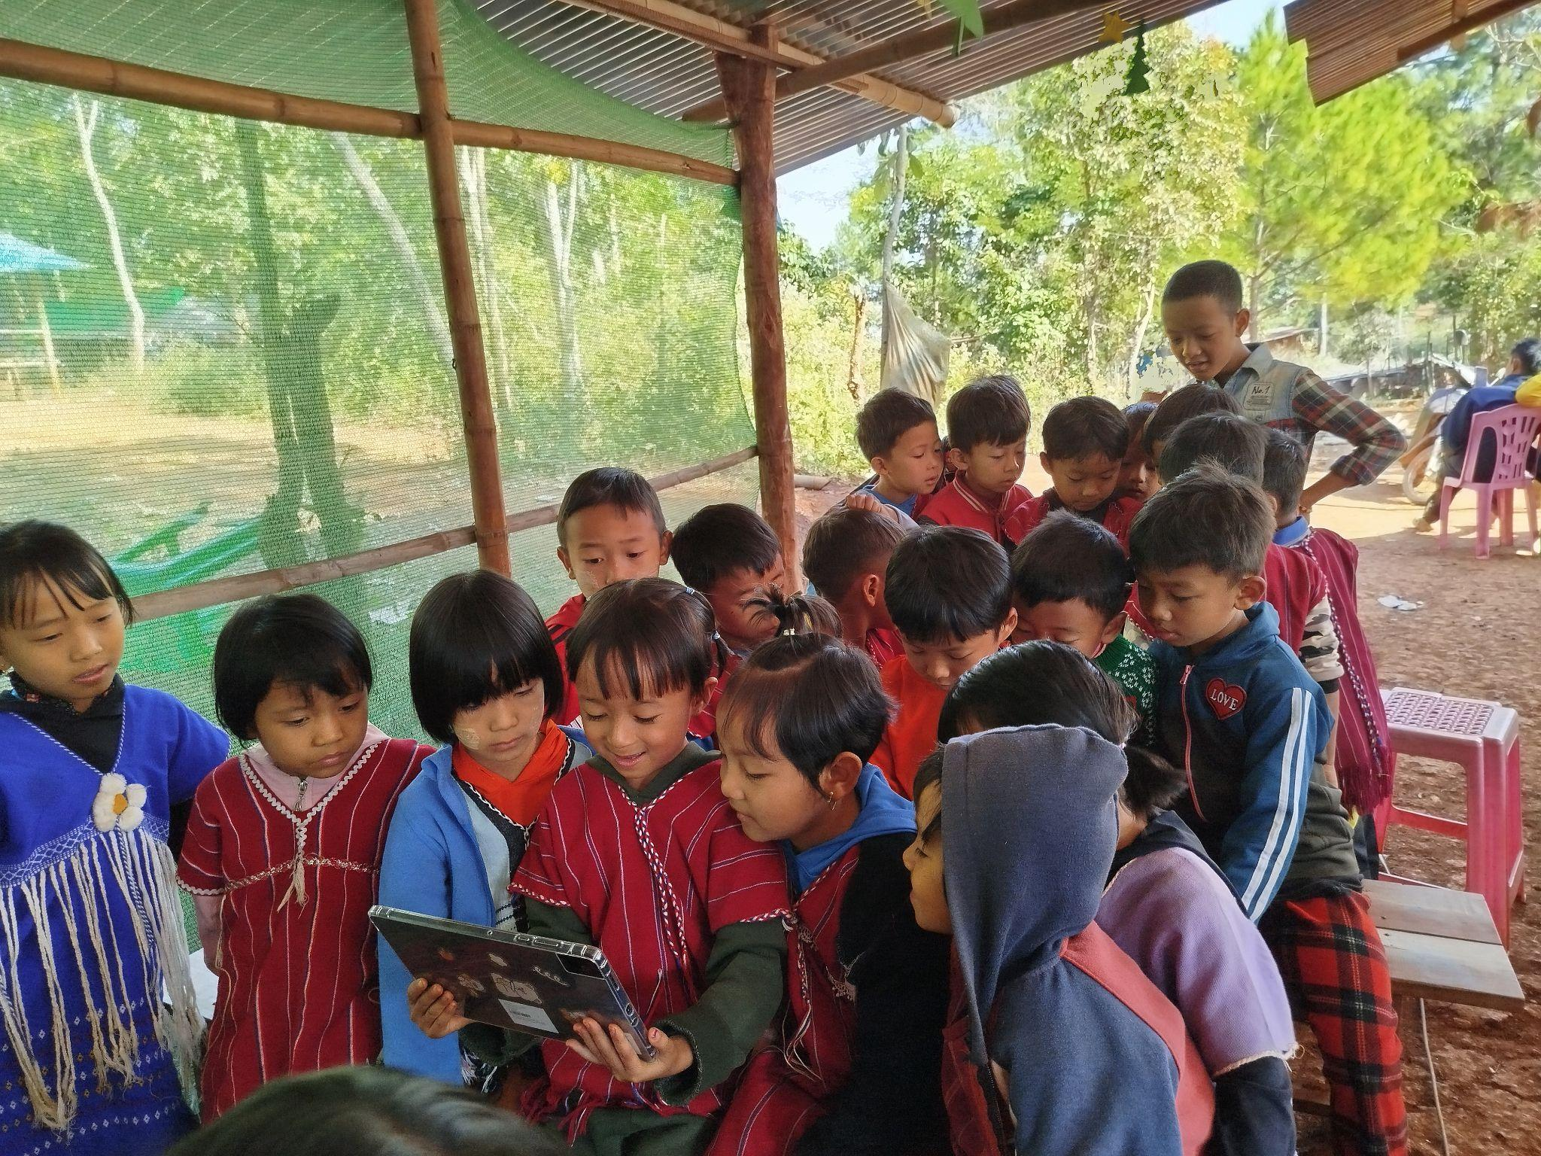
With your support, FLB will reach thousands more children, empowering them with knowledge, dignity, and hope!

